Slide 1
Multimedia Environment
Computer Vision
By Niloufar Kashefi

Slide 2
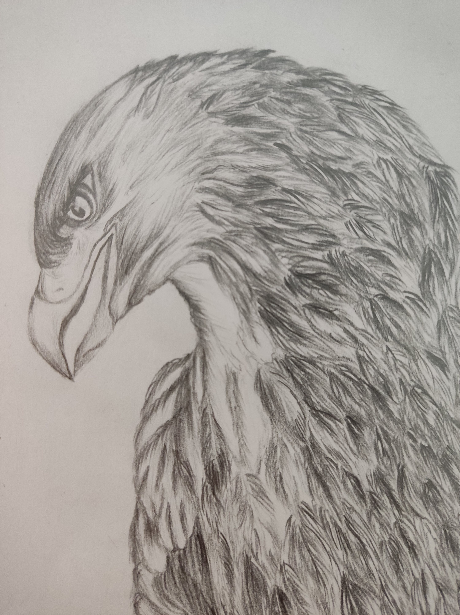
Table of contents
01
02
03
Basic Transformation
Affine Transformation
Perspective Transformation

Slide 3
Basic Transformation
Translate
Resize
Rotate

Slide 4
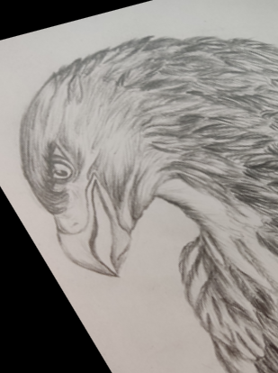
Affine Transformation
Straight lines
Parralle lines
Equal in size

Slide 5

Perspective(Projective) Transformation
Straight lines
Parralle lines
Equal in size

